Slide 1
Partitional Algorithms to Detect Complex Clusters
Kernel K-means
K-means applied in Kernel space
Spectral clustering
Eigen subspace of the affinity matrix (Kernel matrix)
Non-negative Matrix factorization (NMF)
Decompose pattern matrix (n x d) into two matrices: membership matrix (n x K) and weight matrix (K x d)

Slide 2
Kernel K-Means
Radha Chitta
April 16, 2013

Slide 3
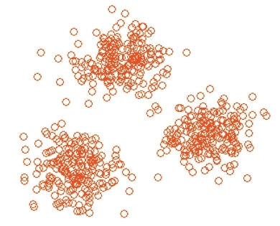
When does K-means work?
K-means works perfectly when clusters are “linearly separable”
Clusters are compact and well separated
Notes:
<numéro>

Slide 4
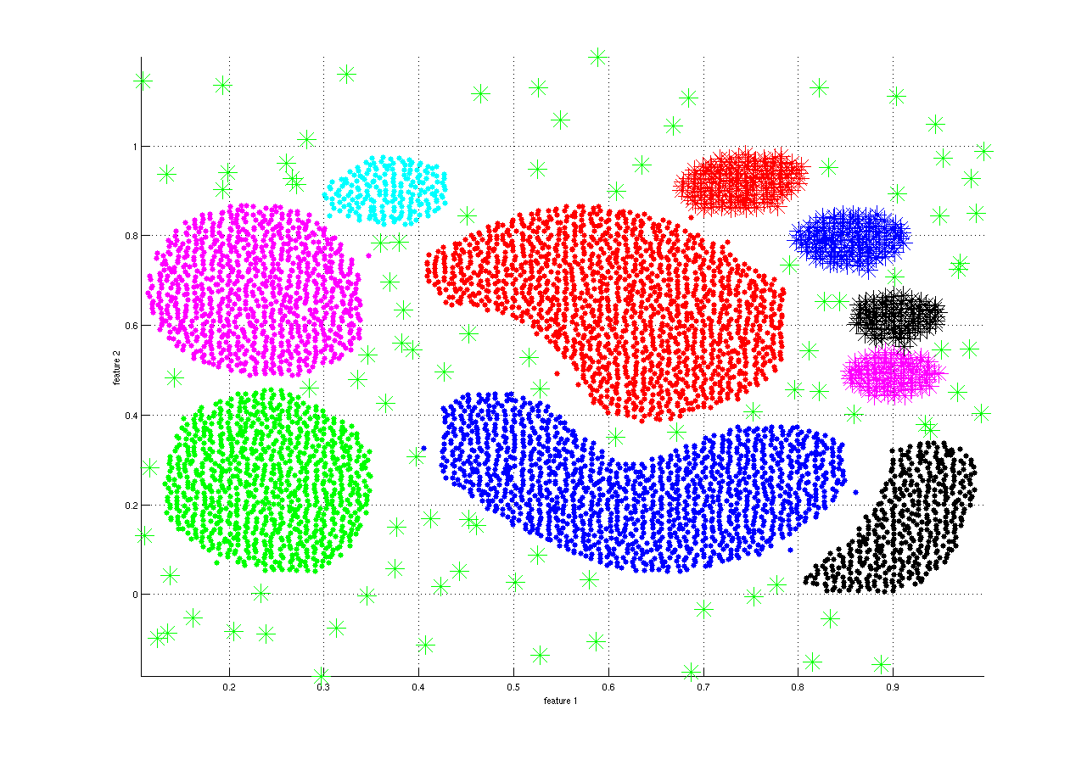
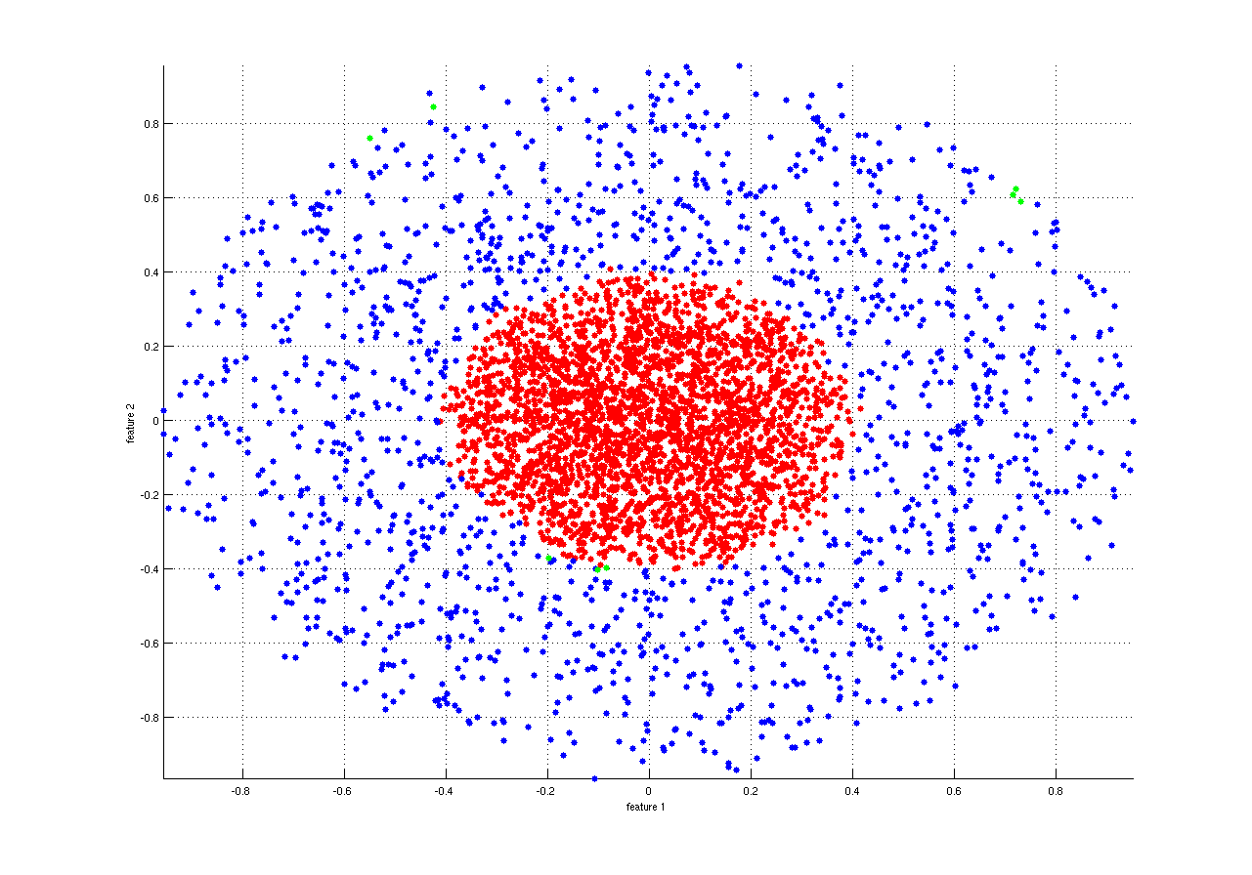
When does K-means not work?
When clusters are “not-linearly separable”
Data contains arbitrarily shaped clusters of different densities
Notes:
<numéro>

Slide 5
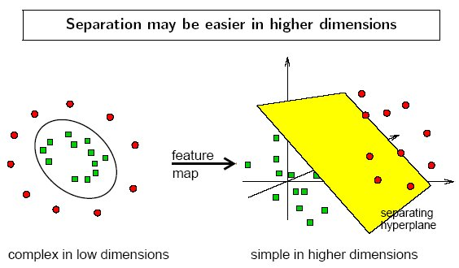
The Kernel Trick Revisited
Notes:
<numéro>

Slide 6
The Kernel Trick Revisited
Map points to feature space using basis function
Replace dot product .with kernel entry
Mercer’s condition:
To expand Kernel function K(x,y) into a dot product, i.e. K(x,y)=Φ(x)⋅Φ(y), K(x, y) has to be positive semi-definite function, i.e., for any function f(x) whose is finite, the following inequality holds
Notes:
<numéro>

Slide 7

Kernel k-means
Minimize sum of squared error:
Kernel k-means:
k-means:
Replace with
Notes:
<numéro>

Slide 8
Kernel k-means
Cluster centers:
Substitute for centers:
Notes:
<numéro>

Slide 9
Kernel k-means
Use kernel trick:
Optimization problem:
K is the n x n kernel matrix, U is the optimal normalized cluster membership matrix
Notes:
Questions?
<numéro>

Slide 10
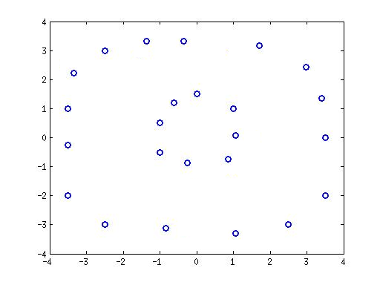
Example
Data with circular clusters
k-means
Notes:
<numéro>

Slide 11
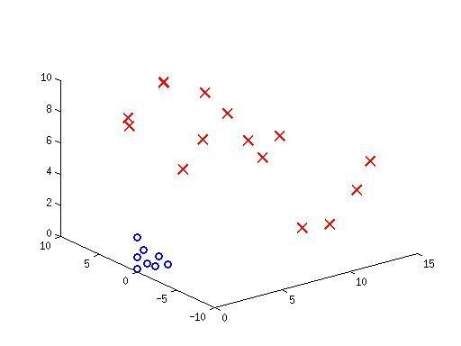
Example
Kernel k-means
Notes:
<numéro>

Slide 12
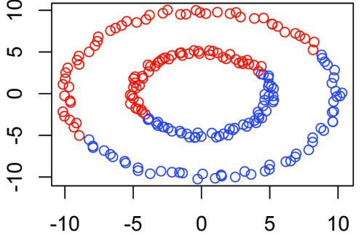
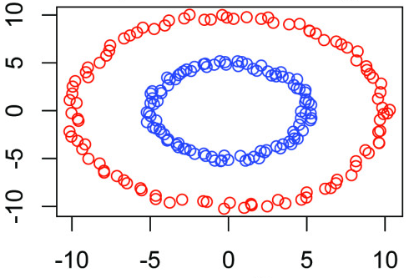
k-means Vs. Kernel k-means
k-means
Kernel k-means
Notes:
<numéro>

Slide 13
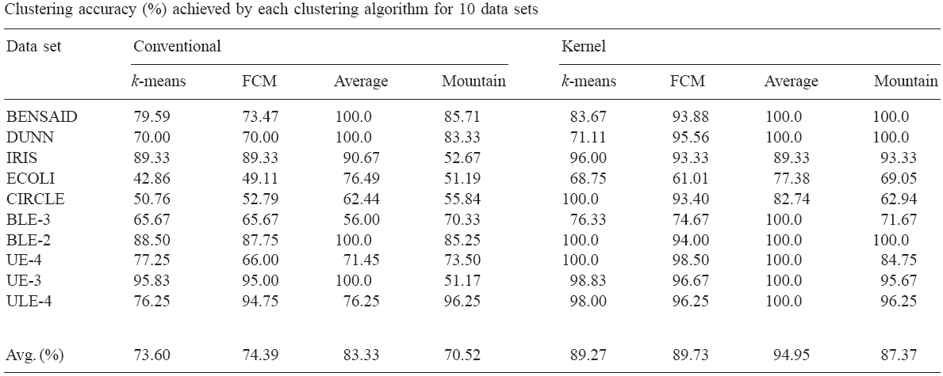
Performance of Kernel K-means
Evaluation of the performance of clustering algorithms in kernel-induced feature space, Pattern Recognition, 2005
Notes:
<numéro>

Slide 14
Limitations of Kernel K-means
More complex than k-means
Need to compute and store n x n kernel matrix
What is the largest n that can be handled?
Intel Xeon E7-8837 Processor (Q2’11), Oct-core, 2.8GHz, 4TB max memory
< 1 million points with “single” precision numbers
May take several days to compute the kernel matrix alone
Use distributed and approximate versions of kernel k-means to handle large datasets
Notes:
Questions?
<numéro>

Slide 15
Spectral Clustering
Serhat Bucak
April 16, 2013

Slide 16
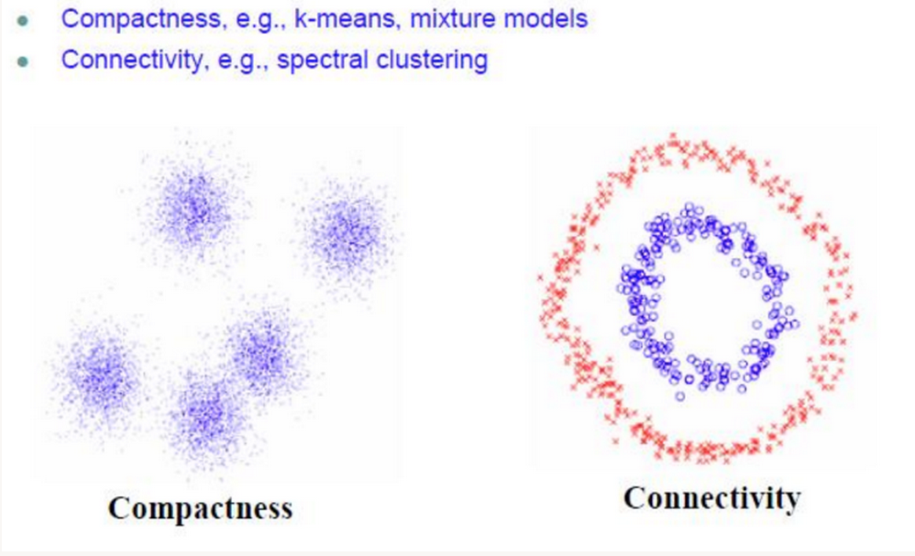
Motivation

Slide 17
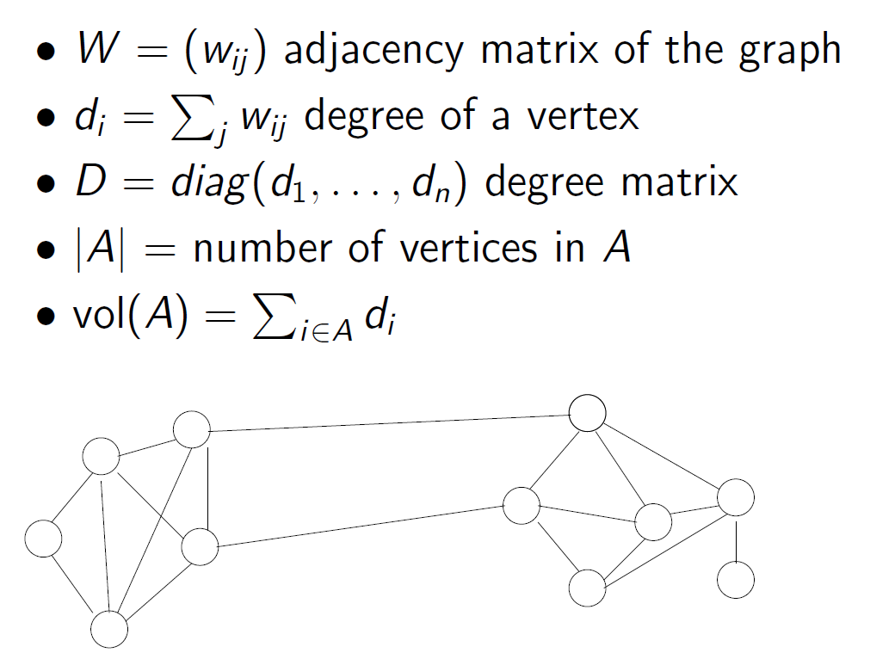
Graph Notation
Hein & Luxburg

Slide 18
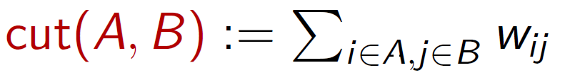
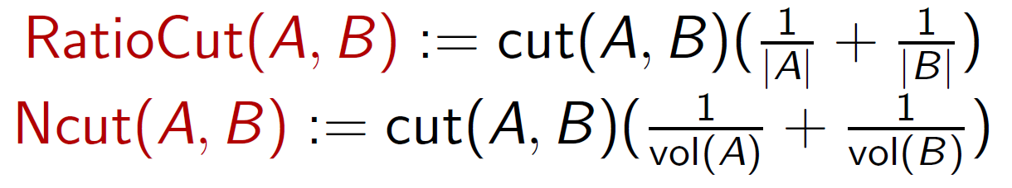
Clustering using graph cuts
Clustering: within-similarity high, between similarity low
minimize
Balanced Cuts:
Mincut can be efficiently solved
RatioCut and Ncut are NP-hard
Spectral Clustering: relaxation of RatioCut and Ncut

Slide 19
Framework
data
Solve the eigenvalue problem:
Lv=λv
Create an Affinity Matrix A
Construct the Graph Laplacian, L, of A
Construct a projection matrix P using these k eigenvectors
Pick k eigenvectors that correspond to smallest k eigenvalues
Project the data:
PTLP
Perform clustering (e.g., k-means) in the new space

Slide 20

Affinity (Similarity matrix)
Some examples
The ε-neighborhood graph: Connect all points whose pairwise distances are smaller than ε
K-nearest neighbor graph: connect vertex vm to vn if vm is one of the k-nearest neighbors of vn.
The fully connected graph: Connect all points with each other with positive (and symmetric) similarity score, e.g., Gaussian similarity function:

Slide 21
Affinity Graph

Slide 22
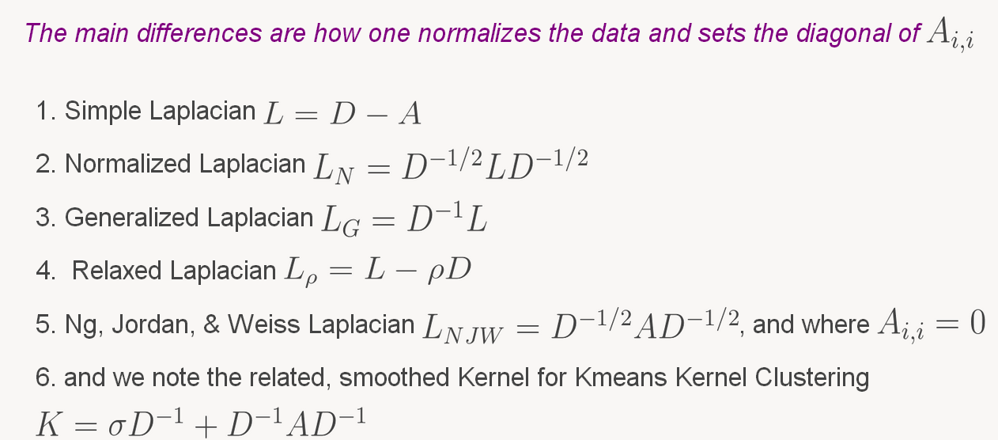
Laplacian Matrix
Matrix representation of a graph
D is a normalization factor for affinity matrix A
Different Laplacians are available
The most important application of the Laplacian is spectral clustering that corresponds to a computationally tractable solution to the graph partitioning problem

Slide 23
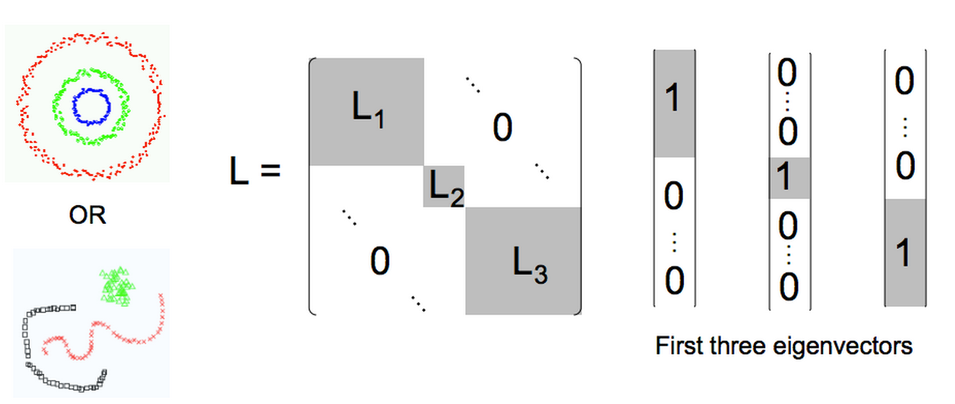
Laplacian Matrix
For good clustering, we expect to have block diagonal Laplacian matrix

Slide 24
Some examples (vs K-means)
Spectral Clustering
K-means Clustering
Ng et al., NIPS 2001

Slide 25
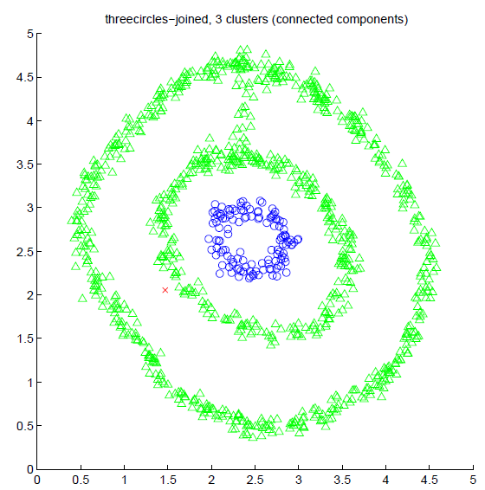
Some examples (vs connected components)
Spectral Clustering
Connected components (Single-link)
Ng et al., NIPS 2001

Slide 26
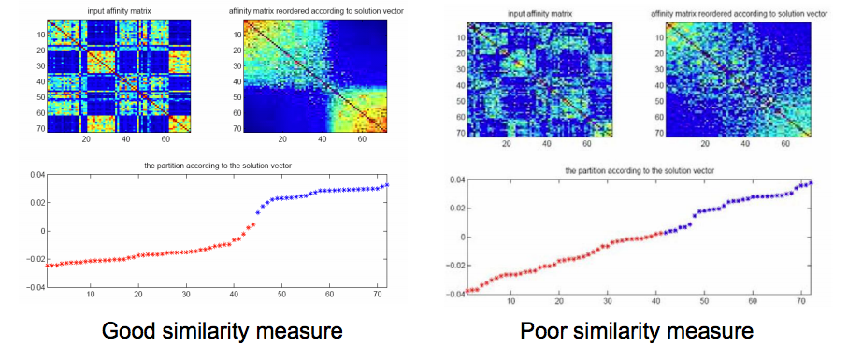
Clustering Quality and Affinity matrix
Plot of the eigenvector with the second smallest value

Slide 27
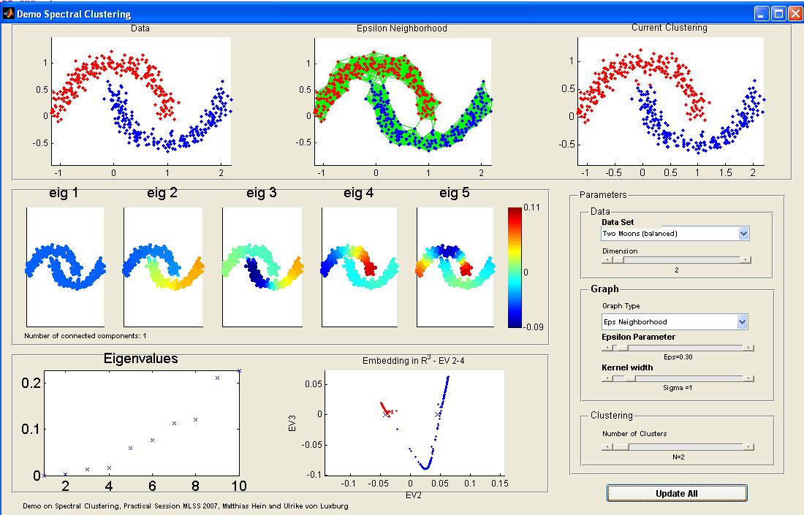
DEMO

Slide 29
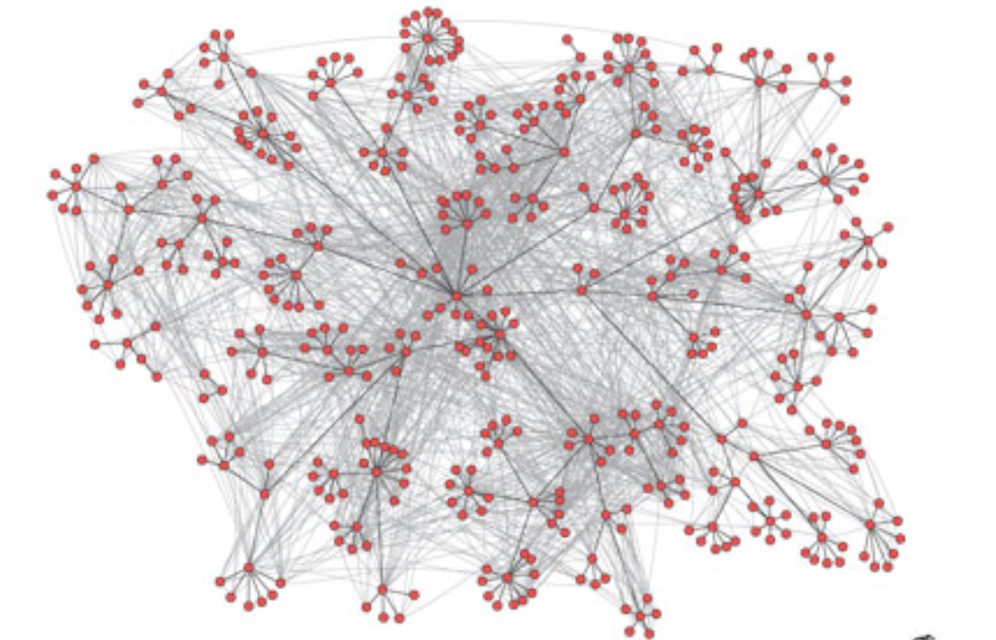
Application: social Networks
Corporate email communication (Adamic and Adar, 2005)
Hein & Luxburg

Slide 30
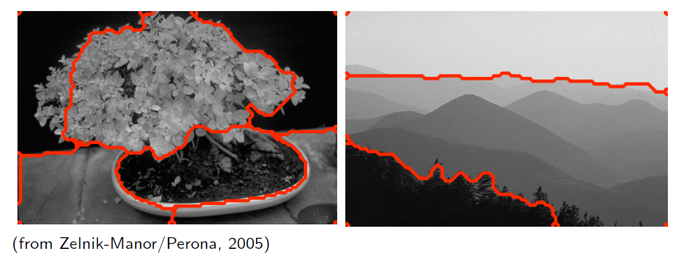
Application: Image Segmentation
Hein & Luxburg

Slide 31
Framework
data
Solve the eigenvalue problem:
Lv=λv
Create an Affinity Matrix A
Construct the Graph Laplacian, L, of A
Construct a projection matrix P using these k eigenvectors
Pick k eigenvectors that correspond to top eigenvectors
Project the data:
PTLP
Perform clustering (e.g., k-means) in the new space

Slide 32
Laplacian Matrix
Given a graph G with n vertices, its n x n Laplacian matrix L is defined as:
L = D - A
L is the difference of the degree matrix D and the adjacency matrix A of the graph
Spectral graph theory studies the properties of graphs via the eigenvalues and eigenvectors of their associated graph matrices: adjacency matrix and the graph Laplacian and its variants
The most important application of the Laplacian is spectral clustering that corresponds to a computationally tractable solution to the graph partitioning problem

